Slide 1
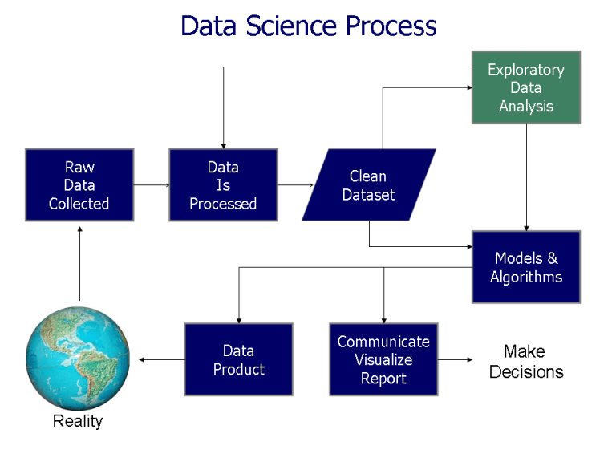

Slide 2
Chapter 04
Distributions and Numerical Descriptive Measures

Slide 3
Background
Population : Includes all of the elements from a set of data.
Sample ：Consists of one or more observations from the population

Slide 4
Background
Parameter : Characteristic of a population, such as a mean or standard deviation. Often notated using Greek letters.
Statistic : A measurable characteristic of a sample.
  Examples of statistics are:
    the mean value of the sample data
    the range of the sample data
    deviation of the data from the sample mean

Slide 5
Background
Sampling distribution : The probability distribution of a given statistic based on a random sample.
Statistical inference : Enables you to make an educated guess about a population parameter based on a statistic computed from a sample randomly drawn from that population.

Slide 6
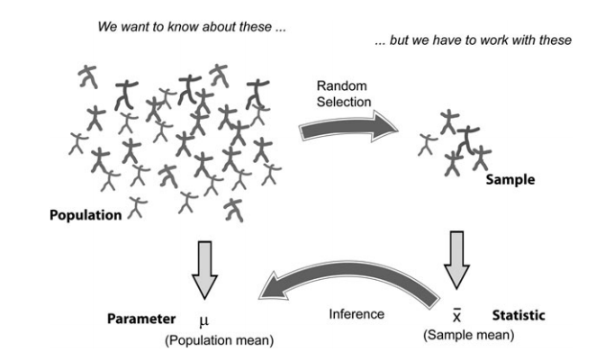
Background

Slide 7
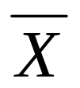





Sample statistics versus population parameters
Measure | Population Parameter | Sample Statistic
Mean
Variance
Standard Deviation
Business Statistics: A First Course, 5e © 2009 Prentice-Hall, Inc.
Chap 3-<number>

Slide 8
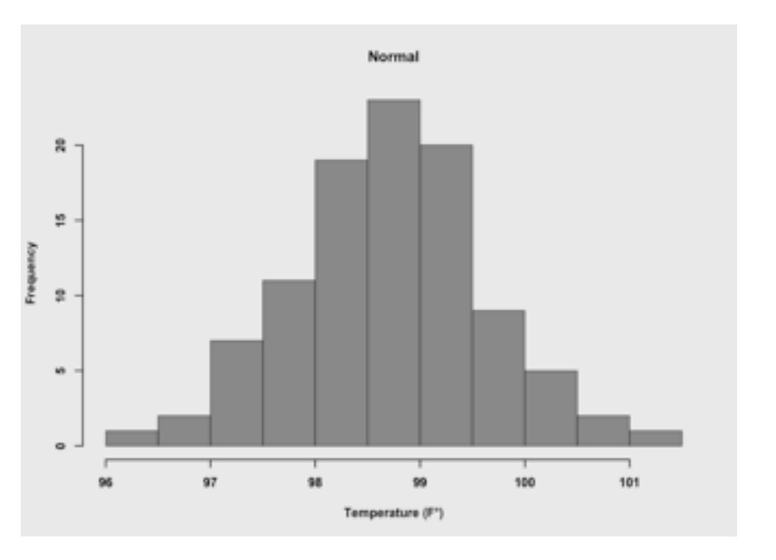
An example: Body Temperature
• A histogram is a type of graph used to display a distribution

Slide 9
An example: Body Temperature
• Histograms can reveal information not captured by summary statistics
  Suppose a few children in a school are sick with influenza (flu) and have a high temperature
    • The distribution will be positively skewed

Slide 10
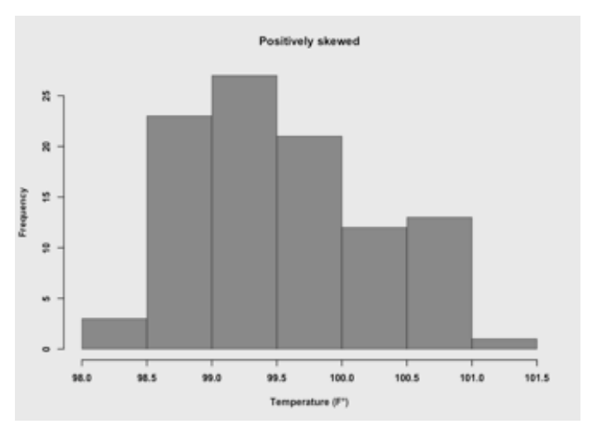
An example: Body Temperature
•

Slide 11
An example: Body Temperature
•Not all distributions are normal
  Suppose one group of children had the flu a week prior to a second sick group of children
  Assume the first group received antiobiotics, which temporarily caused their body temperatures to be slightly below normal, while the second group was still above normal

Slide 12
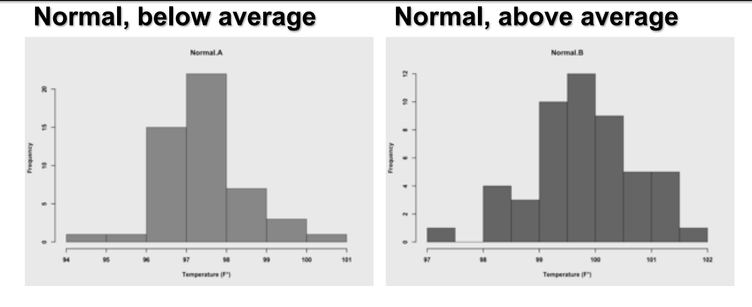
An example: Body Temperature

Slide 13
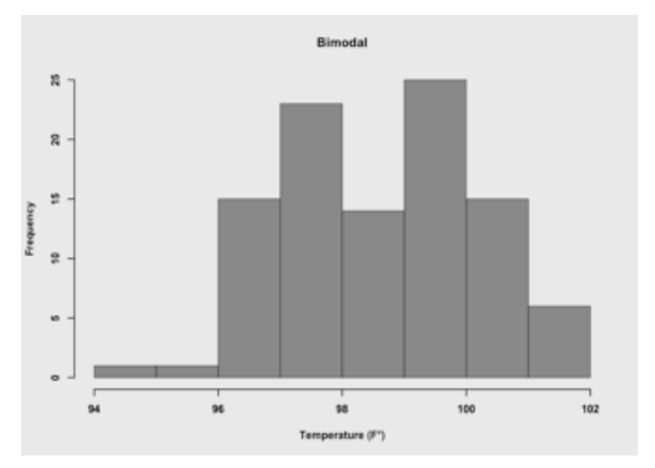
An example: Body Temperature

Slide 14
An example: Body Temperature
• Not all distributions are normal
  – Simply viewing a histogram often reveals whether a distribution is normal or not normal
  – However, sometimes it is hard to determine
    • Summary statistics help in such cases
  – As you view more and more distributions you will get a better sense of what is normal and what is not normal

Slide 15

An example: Wine ratings
• Suppose that 100 wine experts rated the overall quality of 8 different wines on a scale of 1 to 100
  – Higher scores indicate higher quality

Slide 16
An example: Wine ratings
• Suppose four countries submitted two wines each, one red and one white
  – Argentina
  – Australia
  – France
  – USA

Slide 17
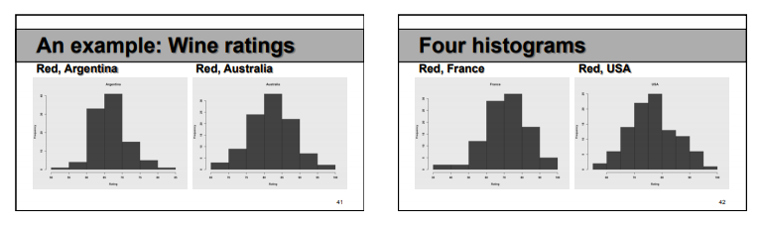
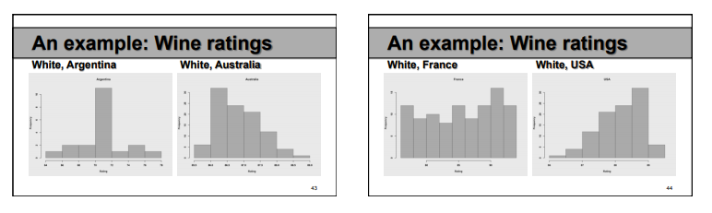
An example: Wine ratings
• The ratings of the red wines are normal
• The ratings of the whites are not normal

Slide 18
Probability Distributions
The mathematical tools to describe the distribution of numerical data in populations and samples are probability distributions.

Slide 19
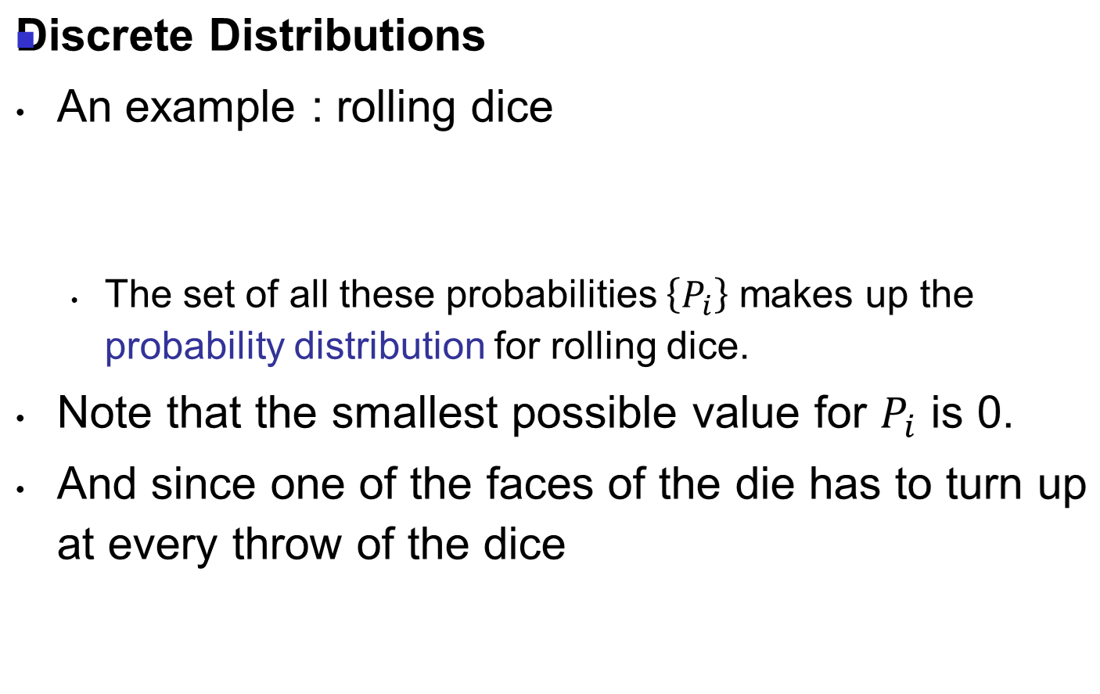


Probability Distributions

Slide 20
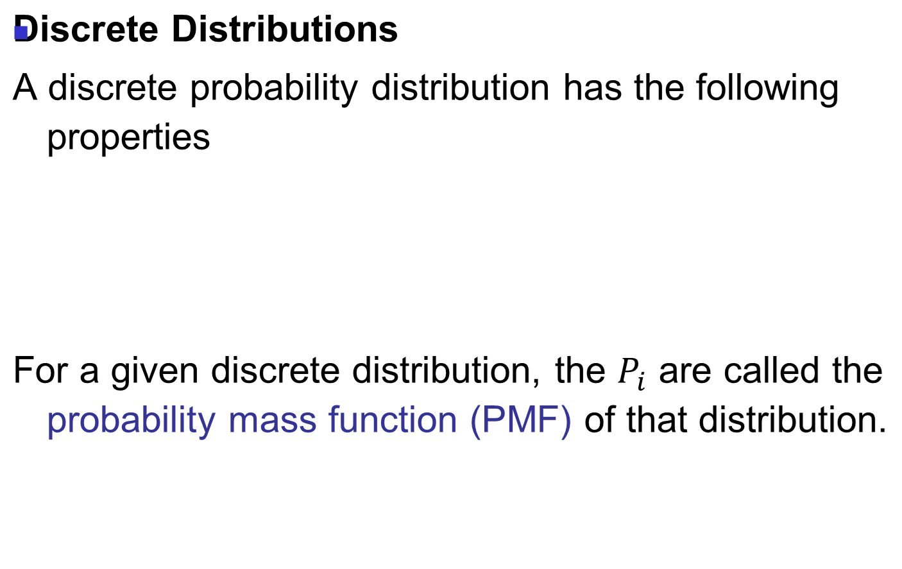

Probability Distributions

Slide 21

Probability Distributions
Continuous Distributions
The curve describing the probability for each value is a continuous function, the probability density function (PDF)

Slide 22
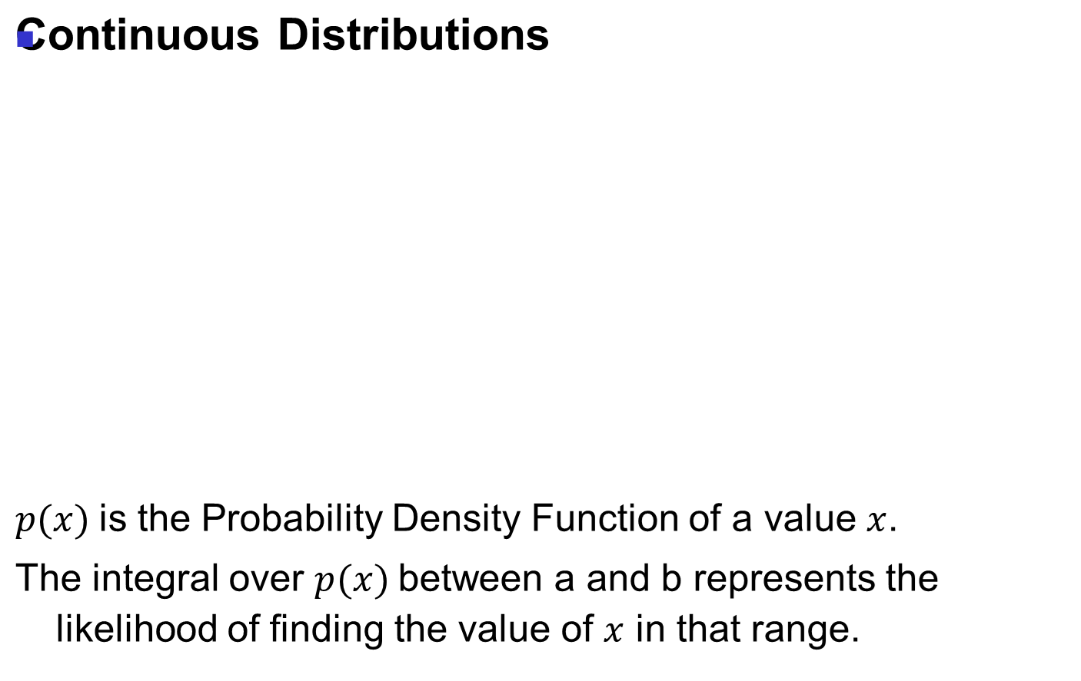
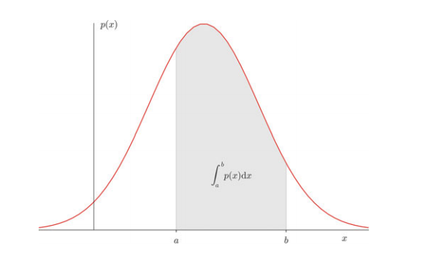
Probability Distributions

Slide 23


Expected Value
The expected value is a function of the probability distribution of the observed value in our population

Slide 24

Variance
The variability of the data is characterized by the variance of the data

Slide 25
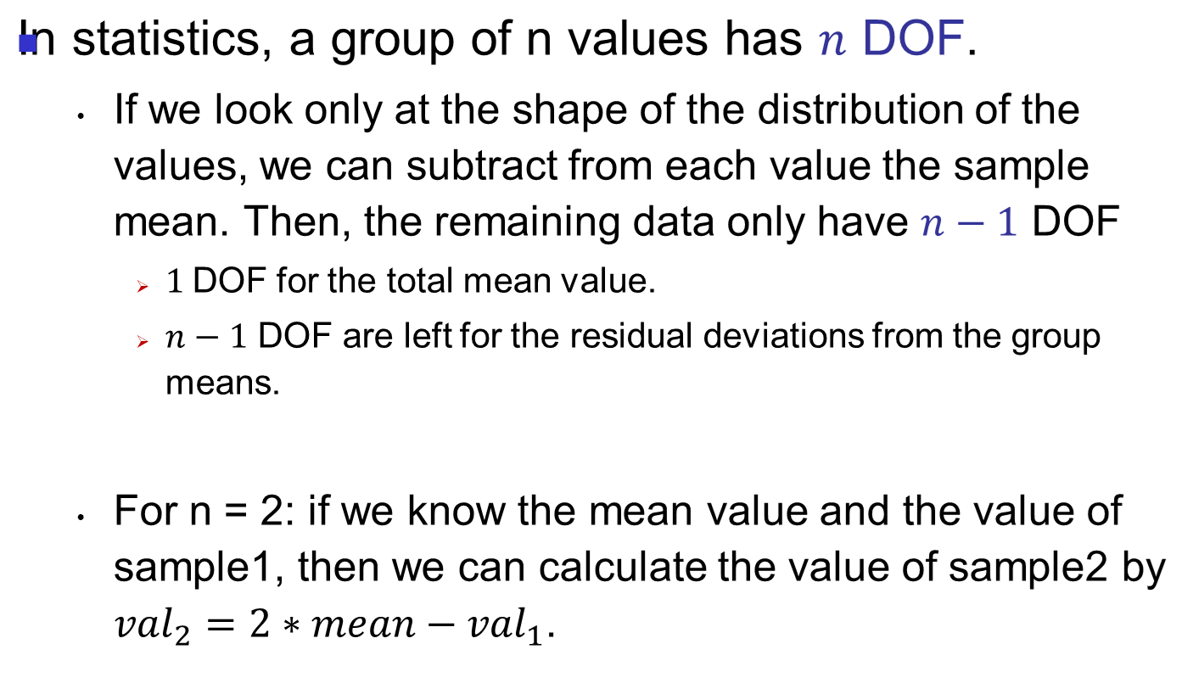
Degrees of Freedom

Slide 26
Measures of Central Tendency
A measure that describes the middle or center point of a distribution
  Mean : the average
  Median : the middle score (the score below which 50% of the distribution falls)
  Mode : the score that occurs most often

Slide 27
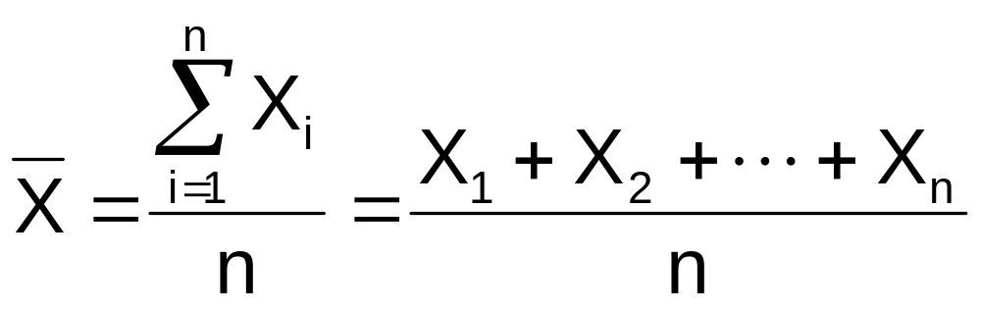
Measures of Central Tendency:
The Mean
The arithmetic mean (often just called “mean”) is the most common measure of central tendency
  For a sample of size n:
Pronounced x-bar
The i^{th} value
Sample size
Observed values
Business Statistics: A First Course, 5e © 2009 Prentice-Hall, Inc.
Chap 3-<number>

Slide 28
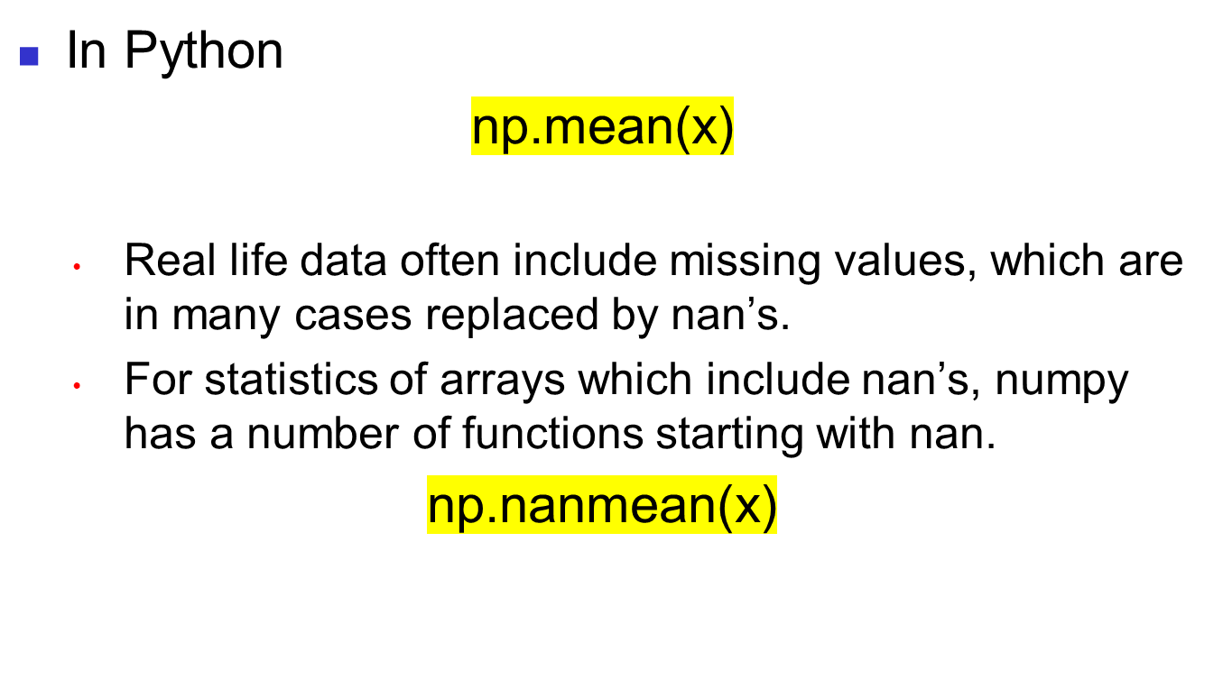
Measures of Central Tendency:
The Mean

Slide 29
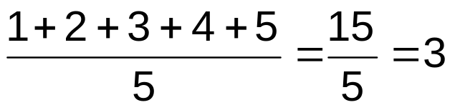
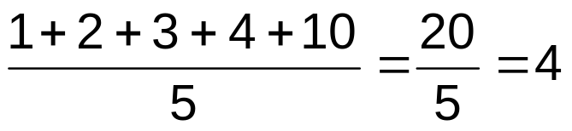
Measures of Central Tendency:
The Mean
(continued)
The most common measure of central tendency
Mean = sum of values divided by the number of values
Affected by extreme values (outliers)
0 1 2 3 4 5 6 7 8 9 10
0 1 2 3 4 5 6 7 8 9 10
Mean = 3
Mean = 4
Business Statistics: A First Course, 5e © 2009 Prentice-Hall, Inc.

Slide 30
Measures of Central Tendency:
The Median
In an ordered array, the median is the “middle” number (50% above, 50% below)
Not affected by extreme values
0 1 2 3 4 5 6 7 8 9 10
0 1 2 3 4 5 6 7 8 9 10
Median = 3
Median = 3
Business Statistics: A First Course, 5e © 2009 Prentice-Hall, Inc.
Chap 3-<number>

Slide 31
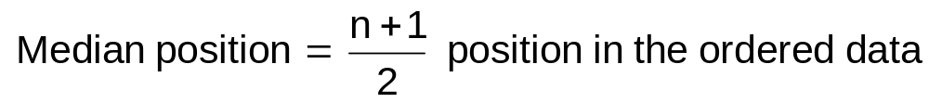
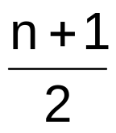
Measures of Central Tendency:
Locating the Median
The location of the median when the values are in numerical order (smallest to largest):
If the number of values is odd, the median is the middle number
If the number of values is even, the median is the average of the two middle numbers
Note that is not the value of the median, only the position of
the median in the ranked data
Business Statistics: A First Course, 5e © 2009 Prentice-Hall, Inc.
Chap 3-<number>

Slide 32
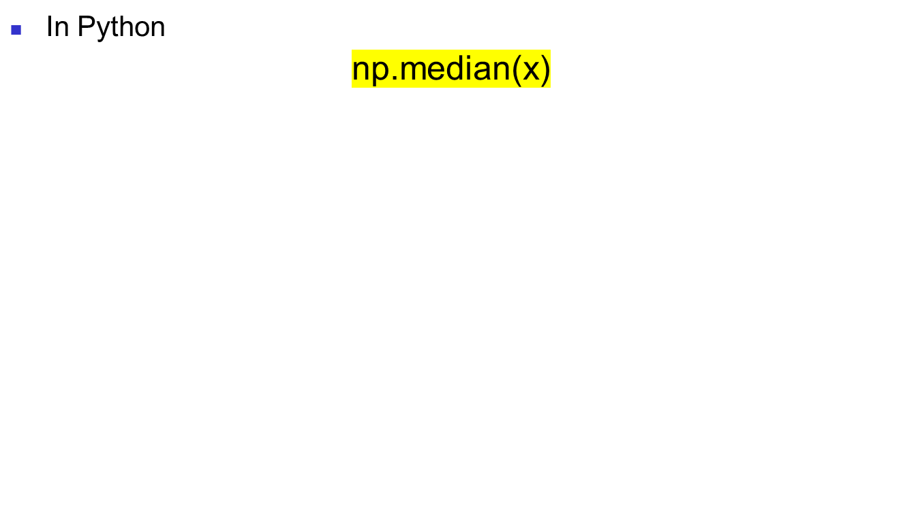
Measures of Central Tendency:
Locating the Median

Slide 33
Measures of Central Tendency:
The Mode
Value that occurs most often
Not affected by extreme values
There may be no mode
There may be several modes
0 1 2 3 4 5 6 7 8 9 10 11 12 13 14
0 1 2 3 4 5 6
No Mode
Mode = 9
Business Statistics: A First Course, 5e © 2009 Prentice-Hall, Inc.
Chap 3-<number>

Slide 34
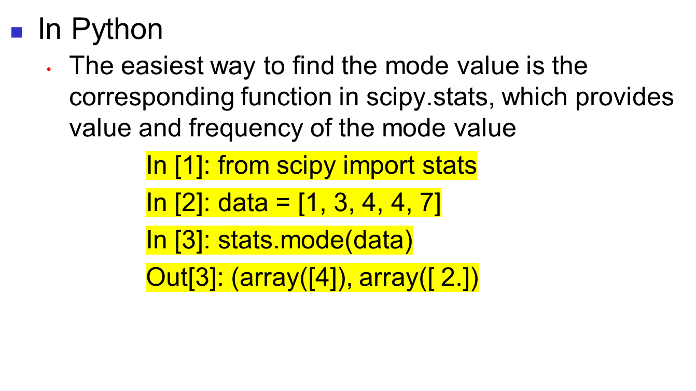
Measures of Central Tendency:
The Mode

Slide 35
Measures of Central Tendency:
Review Example
House Prices:
$2,000,000
$500,000
$300,000
$100,000
$100,000
Sum $3,000,000
Mean: ($3,000,000/5)
= $600,000
Median: middle value of ranked data
= $300,000
Mode: most frequent value
= $100,000
Business Statistics: A First Course, 5e © 2009 Prentice-Hall, Inc.
Chap 3-<number>

Slide 36
Measures of Central Tendency:
Which Measure to Choose?
The mean is generally used, unless extreme values (outliers) exist.
The median is often used, since the median is not sensitive to extreme values. For example, median home prices may be reported for a region; it is less sensitive to outliers.
In some situations it makes sense to report both the mean and the median.
Business Statistics: A First Course, 5e © 2009 Prentice-Hall, Inc.
Chap 3-<number>

Slide 37
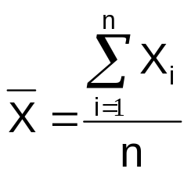
Measures of Central Tendency:
Summary
Central Tendency
Arithmetic Mean
Median
Mode
Middle value in the ordered array
Most frequently observed value
Business Statistics: A First Course, 5e © 2009 Prentice-Hall, Inc.
Chap 3-<number>

Slide 38
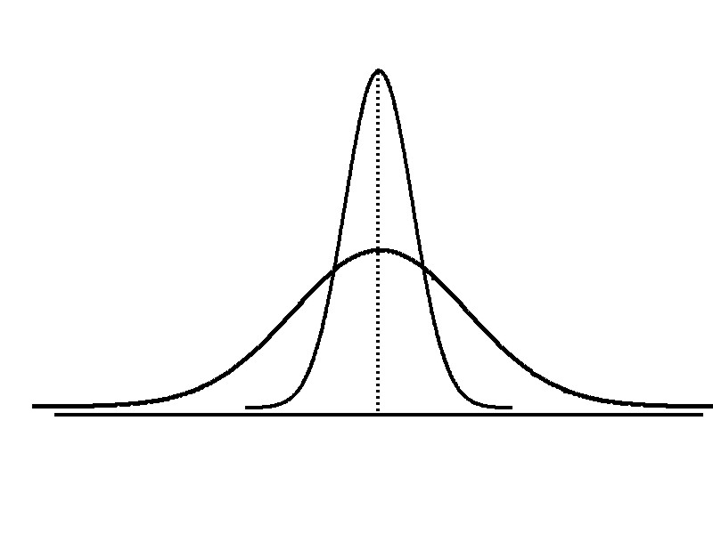
Measures of Variation
Variation
Range
Variance
Standard Deviation
Coefficient of Variation
Measures of variation give information on the spread or variability or dispersion of the data values.
Same center,
different variation
Business Statistics: A First Course, 5e © 2009 Prentice-Hall, Inc.
Chap 3-<number>

Slide 39
Measures of Variation:
The Range
Simplest measure of variation
Difference between the largest and the smallest values:
Range = X_{largest} – X_{smallest}
Example:
0 1 2 3 4 5 6 7 8 9 10 11 12 13 14
Range = 13 - 1 = 12
Business Statistics: A First Course, 5e © 2009 Prentice-Hall, Inc.
Chap 3-<number>

Slide 40
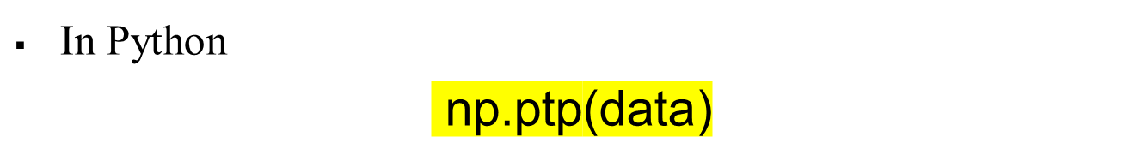
Measures of Variation:
The Range

Slide 41
Measures of Variation:
Why The Range Can Be Misleading
Ignores the way in which data are distributed
Sensitive to outliers
7 8 9 10 11 12
7 8 9 10 11 12
Range = 12 - 7 = 5
Range = 12 - 7 = 5
1,1,1,1,1,1,1,1,1,1,1,2,2,2,2,2,2,2,2,3,3,3,3,4,5
Range = 5 - 1 = 4
1,1,1,1,1,1,1,1,1,1,1,2,2,2,2,2,2,2,2,3,3,3,3,4,120
Range = 120 - 1 = 119
Business Statistics: A First Course, 5e © 2009 Prentice-Hall, Inc.
Chap 3-<number>

Slide 42
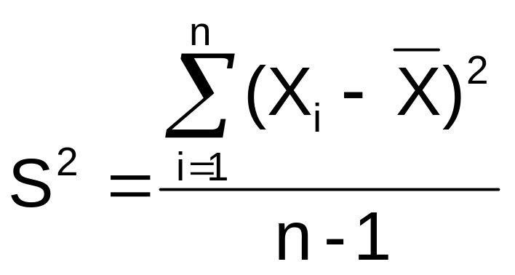

Measures of Variation:
The Variance
Average (approximately) of squared deviations of values from the mean
  Sample variance:
Where
= arithmetic mean
n = sample size
X_{i} = i^{th} value of the variable X
Business Statistics: A First Course, 5e © 2009 Prentice-Hall, Inc.
Chap 3-<number>

Slide 43
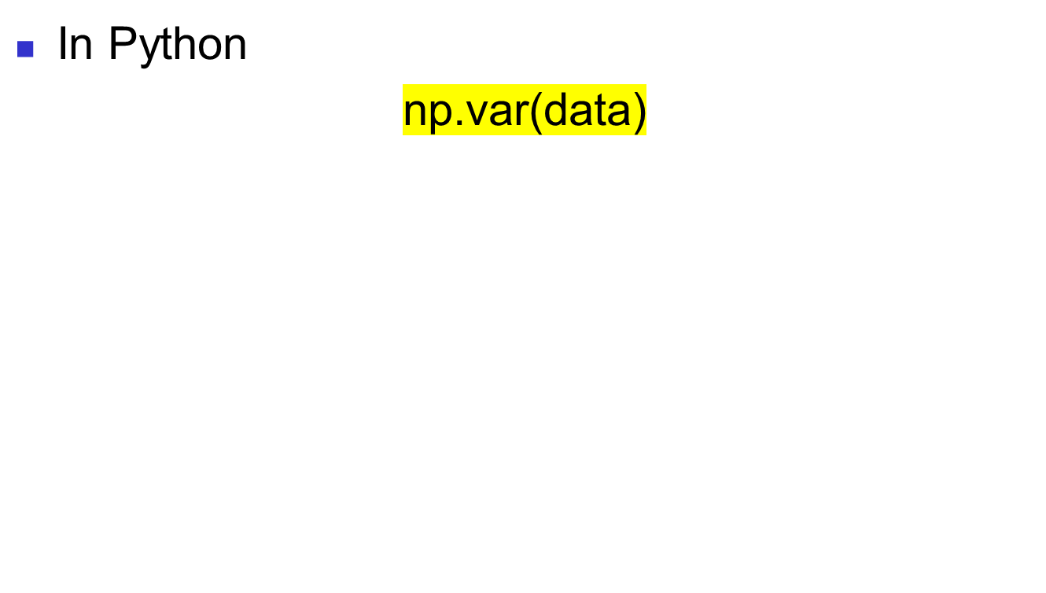
Measures of Variation:
The Variance

Slide 44
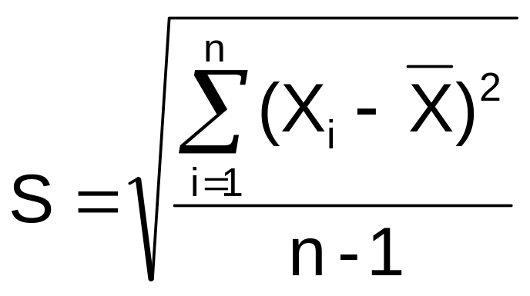
Measures of Variation:
The Standard Deviation
Most commonly used measure of variation
Shows variation about the mean
Is the square root of the variance
  Sample standard deviation:
Business Statistics: A First Course, 5e © 2009 Prentice-Hall, Inc.
Chap 3-<number>

Slide 45
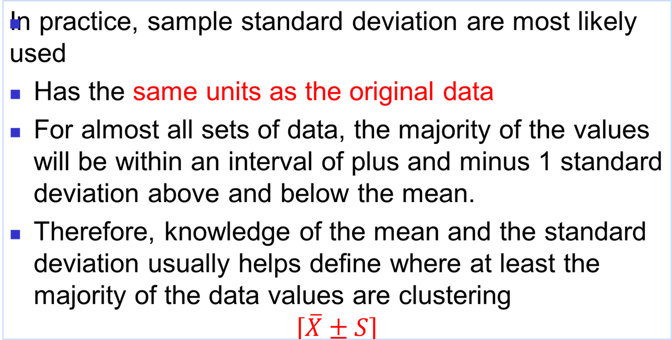
Measures of Variation:
The Standard Deviation
Business Statistics: A First Course, 5e © 2009 Prentice-Hall, Inc.
Chap 3-<number>

Slide 46
Measures of Variation:
The Standard Deviation
Steps for Computing Standard Deviation
1. Compute the difference between each value and the mean.
2. Square each difference.
3. Add the squared differences.
4. Divide this total by n-1 to get the sample variance.
5. Take the square root of the sample variance to get the sample standard deviation.
Business Statistics: A First Course, 5e © 2009 Prentice-Hall, Inc.
Chap 3-<number>

Slide 47
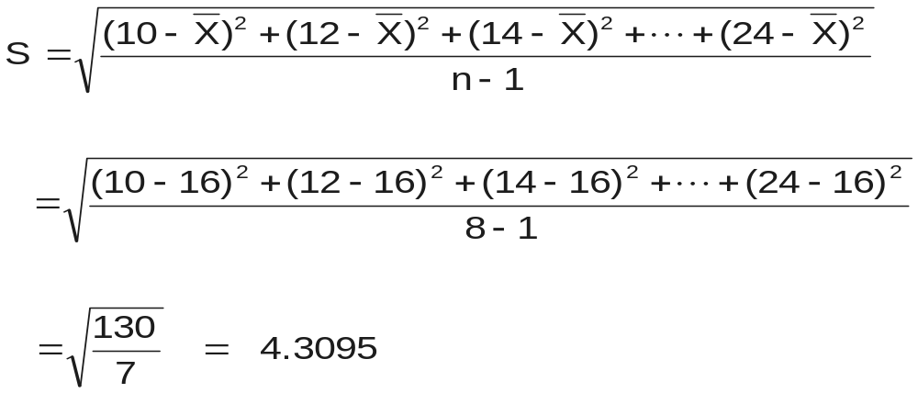
Measures of Variation:
Sample Standard Deviation:
Calculation Example
Sample
Data (X_{i}) : 10 12 14 15 17 18 18 24
n = 8 Mean = X = 16
A measure of the “average” scatter around the mean
Business Statistics: A First Course, 5e © 2009 Prentice-Hall, Inc.
Chap 3-<number>

Slide 48
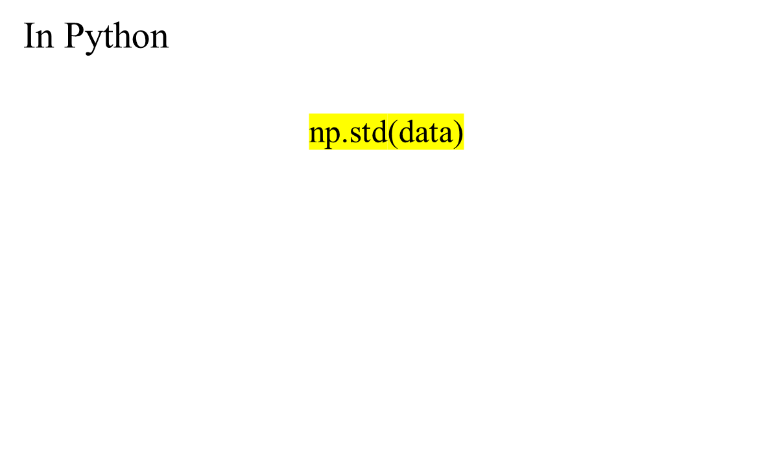
Measures of Variation:
The Standard Deviation

Slide 49
Measures of Variation:
Comparing Standard Deviations
Data A
Mean = 15.5
S = 3.338
11 12 13 14 15 16 17 18 19 20 21
Data B
Mean = 15.5
S = 0.926
11 12 13 14 15 16 17 18 19 20 21
Data C
Mean = 15.5
S = 4.570
11 12 13 14 15 16 17 18 19 20 21
Business Statistics: A First Course, 5e © 2009 Prentice-Hall, Inc.
Chap 3-<number>

Slide 50
Measures of Variation:
Comparing Standard Deviations
Smaller standard deviation
Larger standard deviation
Business Statistics: A First Course, 5e © 2009 Prentice-Hall, Inc.
Chap 3-<number>

Slide 51
Measures of Variation:
Summary Characteristics
The more the data are spread out, the greater the range, variance, and standard deviation.
The more the data are concentrated, the smaller the range, variance, and standard deviation.
If the values are all the same (no variation), all these measures will be zero.
None of these measures are ever negative.
Business Statistics: A First Course, 5e © 2009 Prentice-Hall, Inc.
Chap 3-<number>

Slide 52
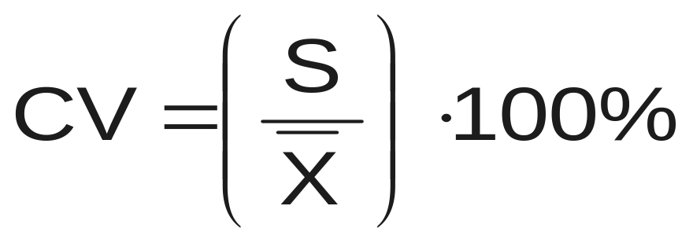
Measures of Variation:
The Coefficient of Variation
Measures relative variation
Always in percentage (%)
Shows variation relative to mean
Can be used to compare the variability of two or more sets of data measured in different units
Business Statistics: A First Course, 5e © 2009 Prentice-Hall, Inc.
Chap 3-<number>

Slide 53
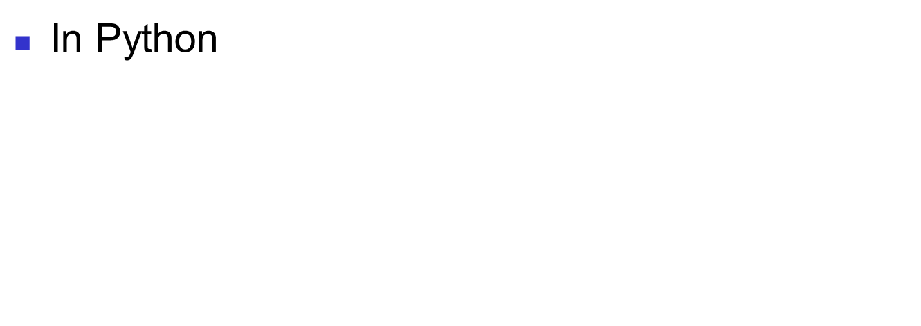
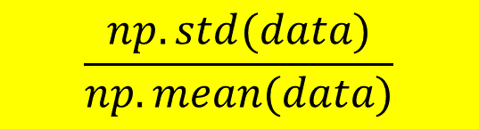
Measures of Variation:
The Coefficient of Variation

Slide 54
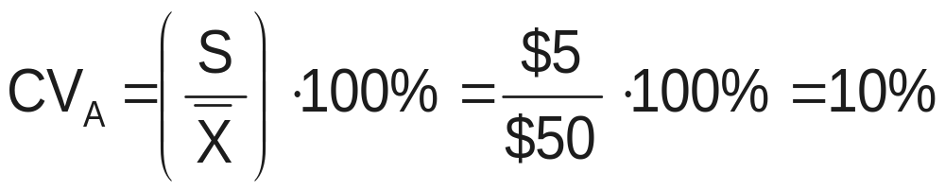
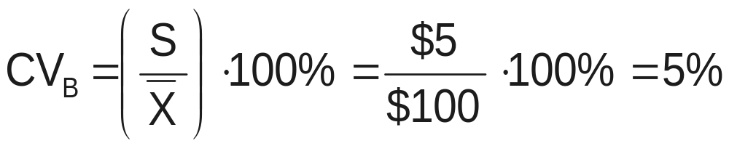
Measures of Variation:
Comparing Coefficients of Variation
Stock A:
  Average price last year = $50
  Standard deviation = $5
Stock B:
  Average price last year = $100
  Standard deviation = $5
Both stocks have the same standard deviation, but stock B is less variable relative to its price
Business Statistics: A First Course, 5e © 2009 Prentice-Hall, Inc.
Chap 3-<number>

Slide 55
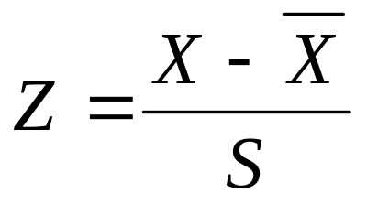
Locating Extreme Outliers:
Z-Score
To compute the Z-score of a data value, subtract the mean and divide by the standard deviation.
where X represents the data value
X is the sample mean
S is the sample standard deviation
Business Statistics: A First Course, 5e © 2009 Prentice-Hall, Inc.
Chap 3-<number>

Slide 56
Locating Extreme Outliers:
Z-Score
The Z-score is the number of standard deviations a data value is from the mean.
A data value is considered an extreme outlier if its Z-score is less than -3.0 or greater than +3.0.
The larger the absolute value of the Z-score, the farther the data value is from the mean.
Business Statistics: A First Course, 5e © 2009 Prentice-Hall, Inc.
Chap 3-<number>

Slide 57
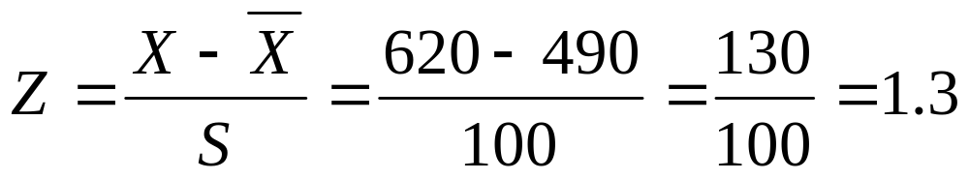
Locating Extreme Outliers:
Z-Score
Suppose the mean math SAT score is 490, with a standard deviation of 100.
Compute the Z-score for a test score of 620.
A score of 620 is 1.3 standard deviations above the mean and would not be considered an outlier.
Business Statistics: A First Course, 5e © 2009 Prentice-Hall, Inc.
Chap 3-<number>

Slide 58
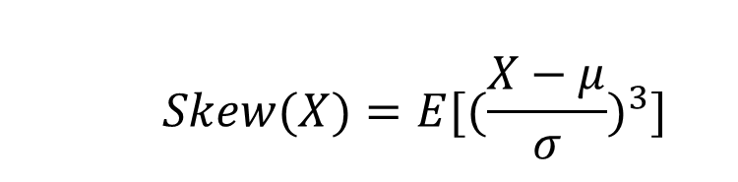
Shape of a Distribution
Describes how data are distributed
Measures of shape: Skewness
  Skewness measures the extent to which the data value are not symmetrical around the mean

Slide 59



Shape of a Distribution
Measures of shape
  Symmetric or skewed
Left-Skewed
Symmetric
Right-Skewed
Mean < Median
Mean = Median
Median < Mean
Business Statistics: A First Course, 5e © 2009 Prentice-Hall, Inc.
Chap 3-<number>

Slide 60
Quartile Measures
Quartiles split the ranked data into 4 segments with an equal number of values per segment
25%
25%
25%
25%
Q1
Q2
Q3
The first quartile, Q₁, is the value for which 25% of the observations are smaller and 75% are larger
Q₂ is the same as the median (50% of the observations are smaller and 50% are larger)
Only 25% of the observations are greater than the third quartile
Business Statistics: A First Course, 5e © 2009 Prentice-Hall, Inc.
Chap 3-<number>

Slide 61
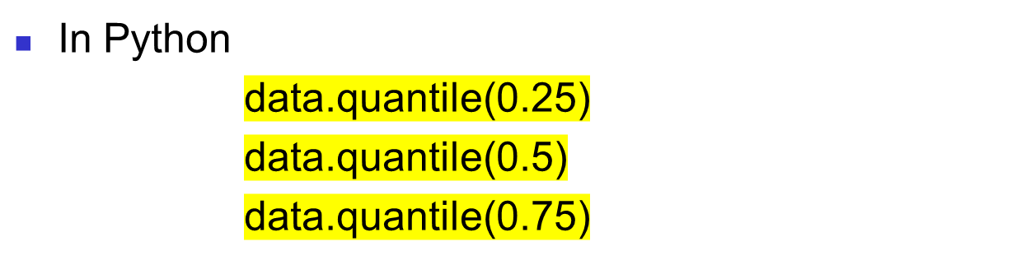
Quartile Measures

Slide 62
Quartile Measures:
Locating Quartiles
Find a quartile by determining the value in the appropriate position in the ranked data, where
First quartile position: Q₁ = (n+1)/4 ranked value
Second quartile position: Q₂ = (n+1)/2 ranked value
Third quartile position: Q₃ = 3(n+1)/4 ranked value
where n is the number of observed values
Business Statistics: A First Course, 5e © 2009 Prentice-Hall, Inc.
Chap 3-<number>

Slide 63
Quartile Measures:
Calculation Rules
When calculating the ranked position use the following rules
  If the result is a whole number then it is the ranked position to use
  If the result is a fractional half (e.g. 2.5, 7.5, 8.5, etc.) then average the two corresponding data values.
  If the result is not a whole number or a fractional half then round the result to the nearest integer to find the ranked position.
Business Statistics: A First Course, 5e © 2009 Prentice-Hall, Inc.
Chap 3-<number>

Slide 64
Quartile Measures
Calculating The Quartiles: Example
Sample Data in Ordered Array: 11 12 13 16 16 17 18 21 22
(n = 9)
Q₁ is in the (9+1)/4 = 2.5 position of the ranked data,
so Q₁ = (12+13)/2 = 12.5
Q₂ is in the (9+1)/2 = 5th position of the ranked data,
so Q₂ = median = 16
Q₃ is in the 3(9+1)/4 = 7.5 position of the ranked data,
so Q₃ = (18+21)/2 = 19.5
Q₁ and Q₃ are measures of non-central location
Q₂ = median, is a measure of central tendency
Business Statistics: A First Course, 5e © 2009 Prentice-Hall, Inc.
Chap 3-<number>
Notes:
so use the value half way between the 2nd and 3rd values,

Slide 65
Quartile Measures:
The Interquartile Range (IQR)
The IQR is Q₃ – Q₁ and measures the spread in the middle 50% of the data
The IQR is also called the midspread because it covers the middle 50% of the data
The IQR is a measure of variability that is not influenced by outliers or extreme values
Measures like Q₁, Q₃, and IQR that are not influenced by outliers are called resistant measures
Business Statistics: A First Course, 5e © 2009 Prentice-Hall, Inc.
Chap 3-<number>

Slide 66
Calculating The Interquartile Range
Example:
Median
(Q₂)
X
X
Q₁
Q₃
minimum
maximum
25% 25% 25% 25%
12 30 45 57 70
Interquartile range
= 57 – 30 = 27
Business Statistics: A First Course, 5e © 2009 Prentice-Hall, Inc.
Chap 3-<number>

Slide 67
The Five Number Summary
The five numbers that help describe the center, spread and shape of data are:
  X_{smallest}
  First Quartile (Q₁)
  Median (Q₂)
  Third Quartile (Q₃)
  X_{largest}
Business Statistics: A First Course, 5e © 2009 Prentice-Hall, Inc.
Chap 3-<number>

Slide 68
Five Number Summary and
The Boxplot
The Boxplot: A Graphical display of the data based on the five-number summary:
X_{smallest} -- Q₁ -- Median -- Q₃ -- X_{largest}
Example:
25% of data 25% 25% 25% of data
of data of data
X_{smallest} Q₁ Median Q₃ X_{largest}
Business Statistics: A First Course, 5e © 2009 Prentice-Hall, Inc.
Chap 3-<number>

Slide 69
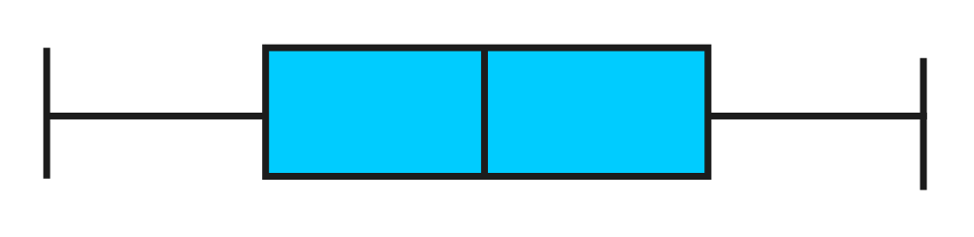
Five Number Summary:
Shape of Boxplots
If data are symmetric around the median then the box and central line are centered between the endpoints
A Boxplot can be shown in either a vertical or horizontal orientation
X_{smallest} Q₁ Median Q₃ X_{largest}
Business Statistics: A First Course, 5e © 2009 Prentice-Hall, Inc.
Chap 3-<number>

Slide 70
Distribution Shape and
The Boxplot
Left-Skewed
Symmetric
Right-Skewed
Q₁
Q₂
Q₃
Q₁
Q₂
Q₃
Q₁
Q₂
Q₃
Business Statistics: A First Course, 5e © 2009 Prentice-Hall, Inc.
Chap 3-<number>

Slide 71
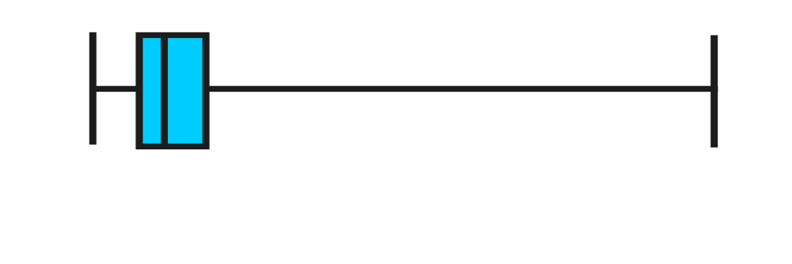
Boxplot Example
Below is a Boxplot for the following data:
0 2 2 2 3 3 4 5 5 9 27
The data are right skewed, as the plot depicts
X_{smallest} Q₁ Q₂ Q₃ X_{largest}
0 2 3 5 27
Business Statistics: A First Course, 5e © 2009 Prentice-Hall, Inc.
Chap 3-<number>

Slide 72
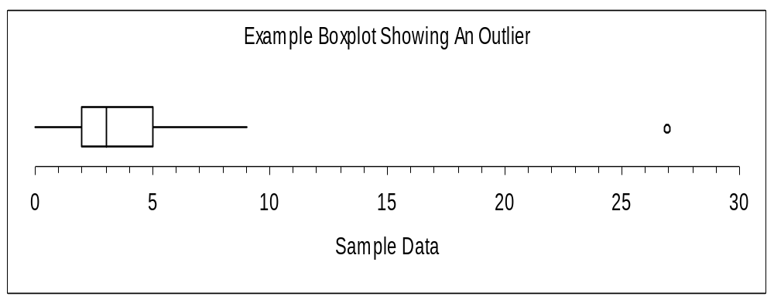
Boxplot example showing an outlier
The boxplot below of the same data shows the outlier value of 27 plotted separately
A value is considered an outlier if it is more than 1.5 times the interquartile range below Q₁ or above Q₃
Business Statistics: A First Course, 5e © 2009 Prentice-Hall, Inc.
Chap 3-<number>

Slide 73
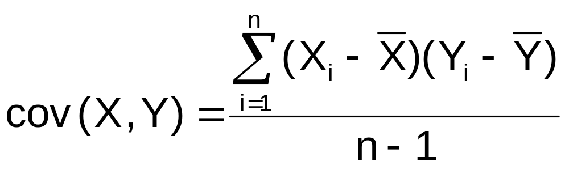
The Covariance
The covariance measures the strength of the linear relationship between two numerical variables (X & Y)
The sample covariance:
Only concerned with the strength of the relationship
No causal effect is implied
Business Statistics: A First Course, 5e © 2009 Prentice-Hall, Inc.
Chap 3-<number>

Slide 74
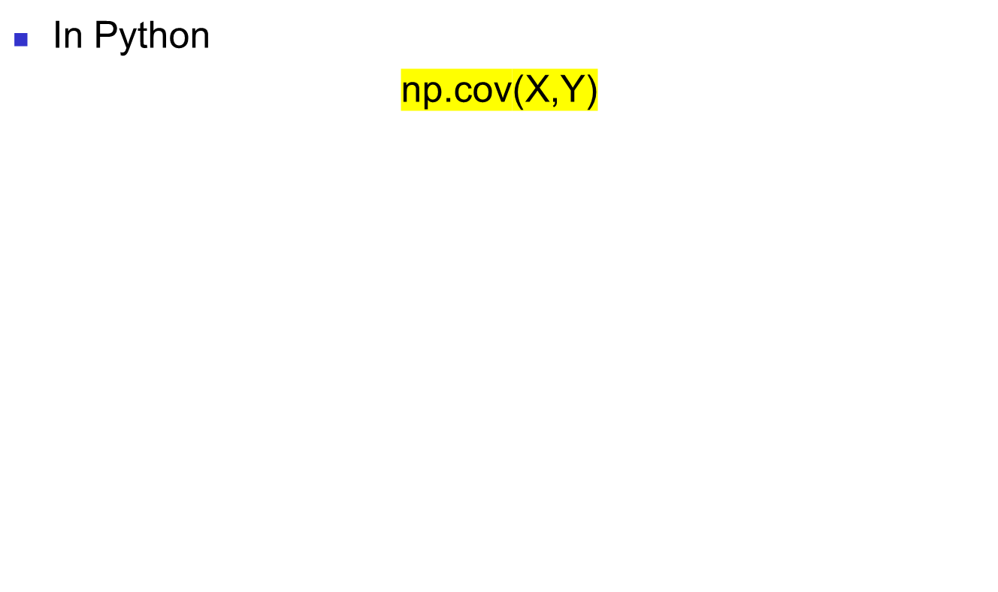
The Covariance

Slide 75
Interpreting Covariance
Covariance between two variables:
cov(X,Y) > 0 X and Y tend to move in the same direction
cov(X,Y) < 0 X and Y tend to move in opposite directions
cov(X,Y) = 0 X and Y are independent
The covariance has a major flaw:
  It is not possible to determine the relative strength of the relationship from the size of the covariance
Business Statistics: A First Course, 5e © 2009 Prentice-Hall, Inc.
Chap 3-<number>

Slide 76
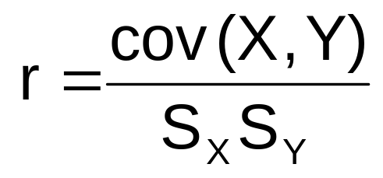
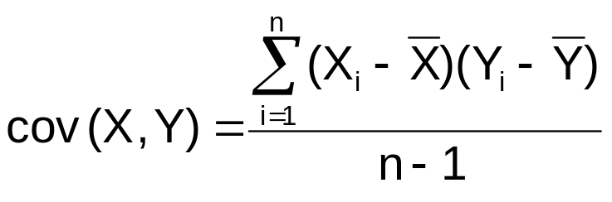
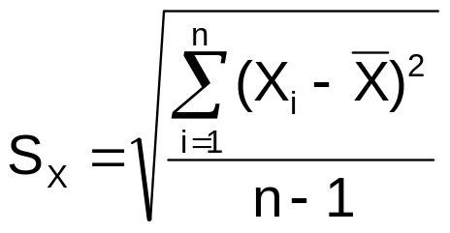

Coefficient of Correlation
Measures the relative strength of the linear relationship between two numerical variables
Sample coefficient of correlation:
where
Business Statistics: A First Course, 5e © 2009 Prentice-Hall, Inc.
Chap 3-<number>

Slide 77
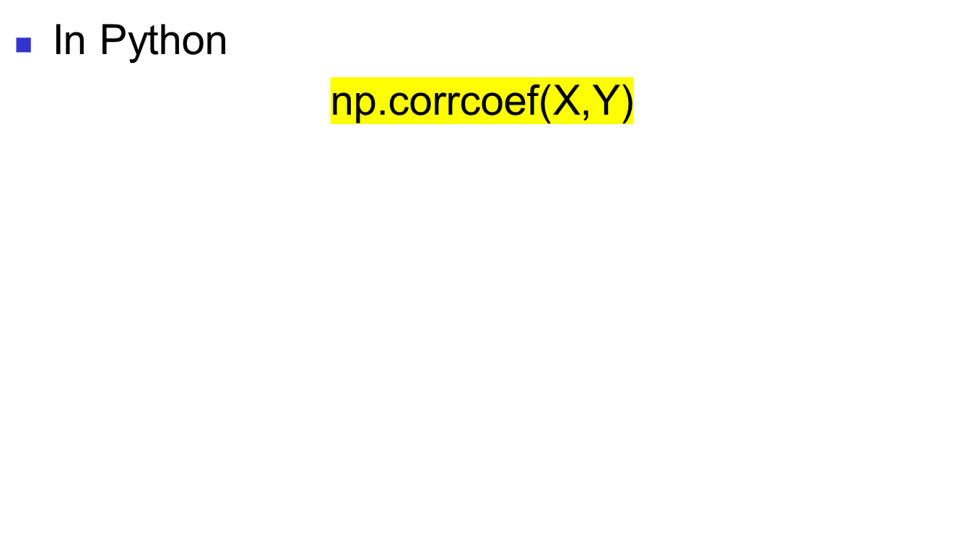
Coefficient of Correlation

Slide 78
Features of the
Coefficient of Correlation
The population coefficient of correlation is referred as ρ.
The sample coefficient of correlation is referred to as r.
Either ρ or r have the following features:
  Unit free
  Ranges between –1 and 1
  The closer to –1, the stronger the negative linear relationship
  The closer to 1, the stronger the positive linear relationship
  The closer to 0, the weaker the linear relationship
Business Statistics: A First Course, 5e © 2009 Prentice-Hall, Inc.
Chap 3-<number>

Slide 79
Scatter Plots of Sample Data with Various Coefficients of Correlation
Y
Y
X
X
r = -1
r = -.6
Y
Y
Y
X
X
X
r = +1
r = +.3
r = 0
Business Statistics: A First Course, 5e © 2009 Prentice-Hall, Inc.
Chap 3-<number>

Slide 80
Chapter Summary
Described measures of central tendency
  Mean, median, mode
Described measures of variation
  Range, interquartile range, variance and standard deviation, coefficient of variation, Z-scores
Illustrated shape of distribution
  Symmetric, skewed
Described data using the 5-number summary
  Boxplots
Discussed covariance and correlation coefficient

